Slide 1
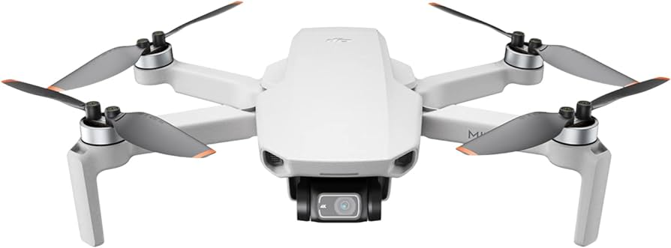
Final Software Engineering Presentation - Group 14
Shreyas Srinivasa, Shrijan Pant, Sean-Morgan Neville, Venkata Lohithakshith Veerepalli

Slide 2

Goals
A Java/JavaFX program employing diverse design patterns (adapter, singleton, visitor, and composite) to orchestrate virtual drone operations on a simulated farm. The user interface facilitates the selection of various functions at any given moment.
Features :-
Management a catalog of items and item containers situated on the farm.
Facilitation of the addition or modification of various attributes related to items and item containers.
Virtual drone ability to visit different items and item containers within the virtual farm.
Virtual drone ability to execute a comprehensive scan of the entire agricultural property.

Slide 3
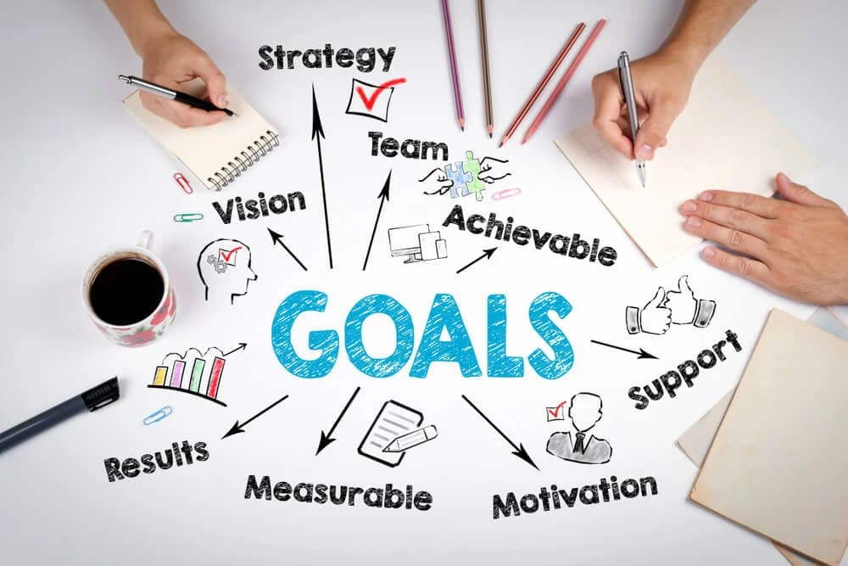
Goals
Establishing a connection to an actual Tello Quadcopter drone using the same user interface to perform various physical drone functions.
Features :-
Capability of navigation to physical items positioned within a 32x24 foot
area.
Capability to conduct a scan of the same 32x24 foot region.

Slide 4
Team Organization
The team structure is flexible, with decisions determined by a majority consensus.
Group decisions shape communication protocols and general group activities.
Individual roles for assignments are designated through volunteer participation.
Group discussions are convened to address any issues arising in team communication.
Team communication primarily takes place on Discord, utilizing a dedicated group server.

Slide 5
Workflow
Instructions were issued through multiple assignments.
Team meetings facilitated the detailed specification of requirement implementations.
Project requirements were divided into various segments, with individuals opting for specific parts aligned with their proficiency and comfort level.

Slide 6
Workflow
The transformation of requirements into specifications involved the creation of comprehensive use cases and UML diagrams, including class diagrams, state chart diagrams, and sequence diagrams. The division and integration of work were delineated, specifying how tasks were allocated and merged.
Project specifications were segmented into distinct parts, with individuals opting for assignments aligned with their comfort and proficiency, signifying a collaborative approach to task distribution.

Slide 7
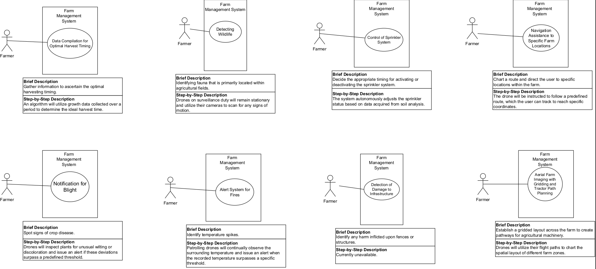
Specifications - Use Case Diagram

Slide 8
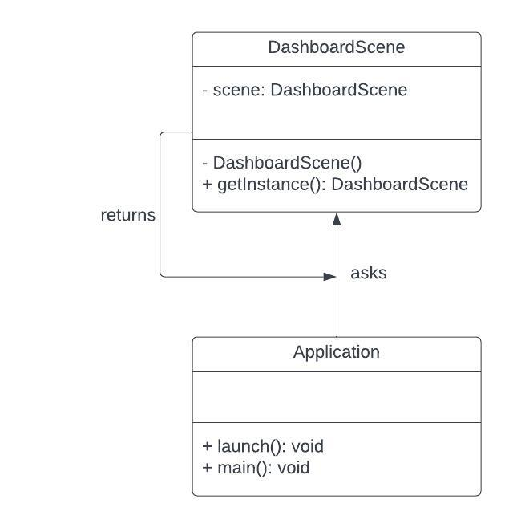
Specifications - Singleton Pattern

Slide 9
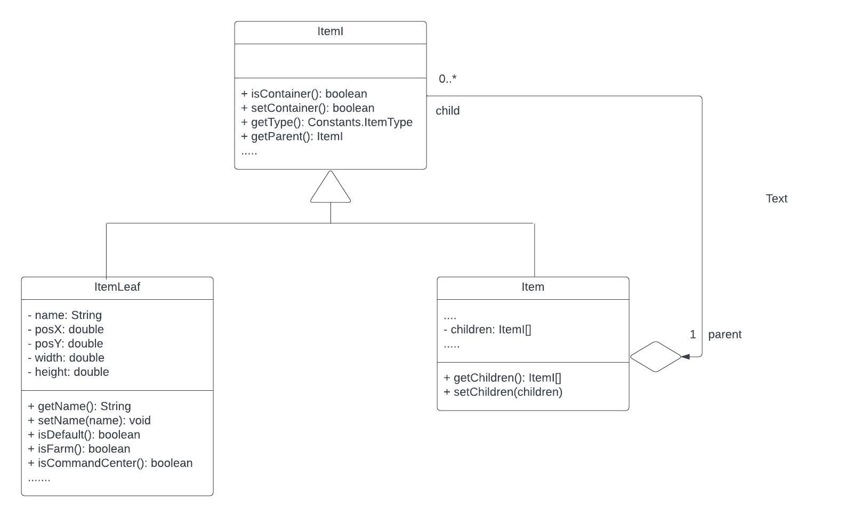
Specifications - Composite Pattern

Slide 10
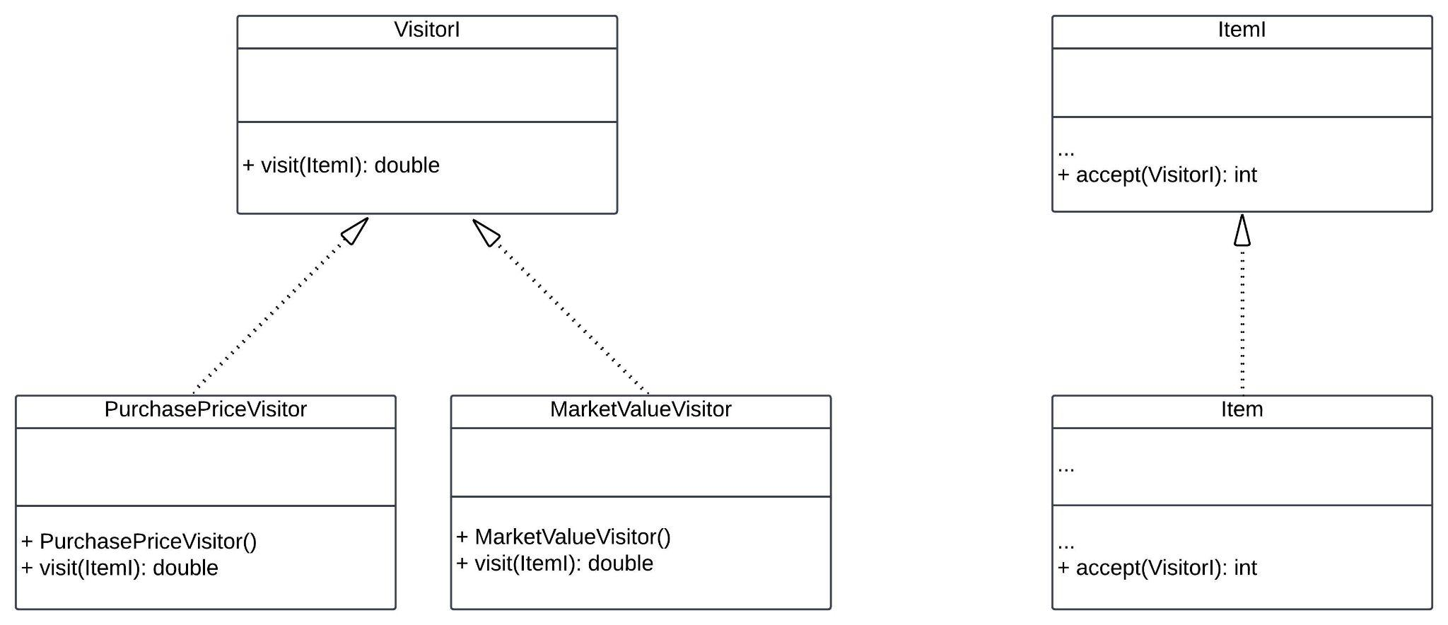
Specifications - Visitor Pattern

Slide 11
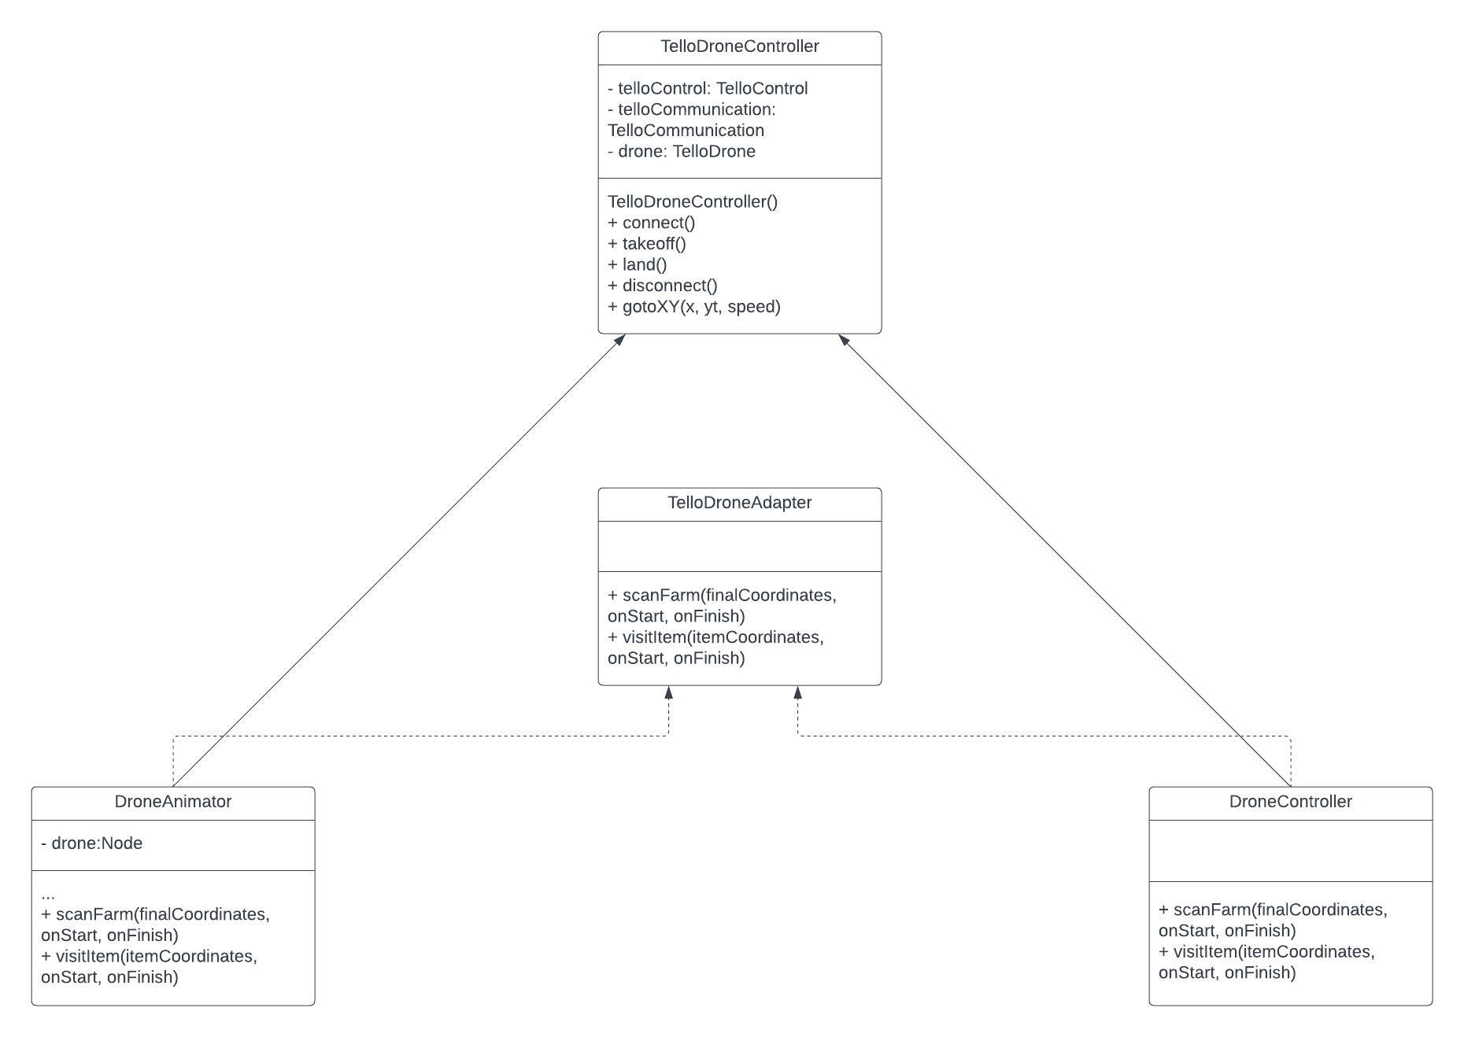
Specifications - Adapter Pattern

Slide 12
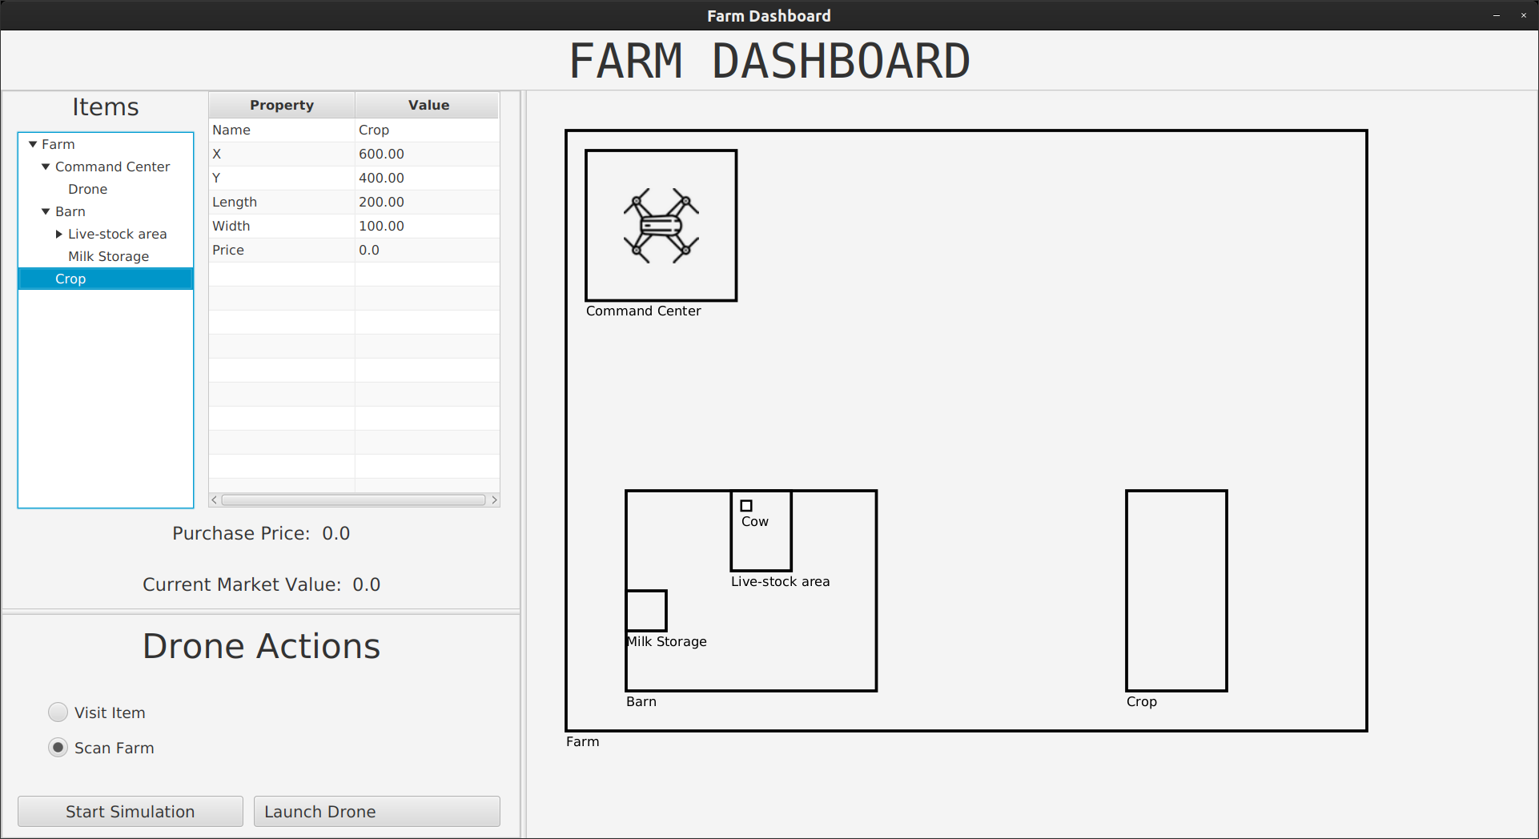
Specifications - Dashboard

Slide 13
Design and Implementation
A team meeting was conducted to precisely define the design requirements.
The assignment was partitioned into multiple segments for efficient handling.
A list of distinct assignment components was formulated, and individuals volunteered by signing up for specific parts.
Subsequently, collaborative efforts were initiated, with different team members pooling their contributions to develop a unified implementation.

Slide 14
Testing
Simulation:
Thorough testing of each facet of the dashboard and simulation was conducted to align with specified requirements and adhere to standard usage parameters.
Examples of testing scenarios include ensuring that items do not surpass the size limits of their containers.
Care was taken to avoid exceeding the spatial boundaries of the farm within the simulation.
The drone's functionality is rigorously tested to confirm correct execution in tasks such as visiting items and accurately scanning the entire farm.

Slide 15
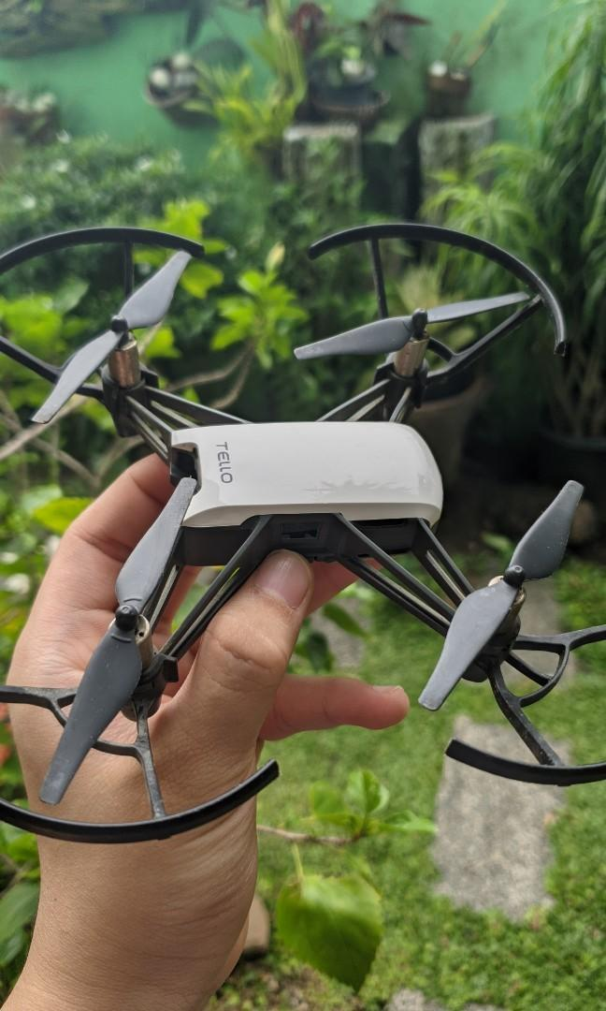
Testing
Tello Drone:
A practical test involved the Tello Drone being taken to a park where a 32x24 foot area was mapped out to evaluate the drone's scanning and visiting capabilities.

Slide 16
Learnings
Real-life Utility of Design Patterns:
Exploring practical applications and benefits of design patterns in solving common programming challenges, enhancing code maintainability, and fostering scalability in real-world scenarios.
Real-life Implementation of Design Patterns:
Examining instances where design patterns have been effectively applied in actual projects, illustrating how they contribute to code clarity, adaptability, and efficiency.
Creating a UI with JavaFX:
Providing guidance on building user interfaces using JavaFX, covering essential concepts, tools, and techniques for designing visually appealing and functional graphical interfaces.

Slide 17
Learnings
Creating Different UML Diagrams and Their Utility in Large Projects:
Offering insights into creating various Unified Modeling Language (UML) diagrams such as use cases, class diagrams, state chart diagrams, and sequence diagrams. Understanding their significance and practical applications in managing complexity in large-scale projects.
Communication and Teamwork Skills:
Addressing the importance of effective communication and teamwork in professional settings. Providing strategies for fostering clear communication, collaboration, and constructive teamwork, essential for successful project execution and a positive work environment.

Slide 18
Image Resources
https://www.amazon.com/DJI-Mini-Ultralight-Quadcopter-Transmission/dp/B07FSQ6BGV
https://www.breathehr.com/en-gb/blog/topic/company-culture/five-goals-for-your-business-company-culture
https://www.carousell.ph/p/dji-tello-drone-1102980943/

